Slide 1
Introduction to Java for C++
Programmers
Segment 3 – JavaFX Basics
Professor: Mahboob Ali

Slide 2
Introduction
Graphical User Interface (GUI) applications, as opposed to console UI applications, rely heavily on objects
JavaFX is a framework and (large) set of objects we can use to develop GUI-based applications
The JavaFX API is a good example of how object-oriented principles can be applied in software development

Slide 3

Introduction
This lecture covers creating the UI, but it will be very simple, and it won’t actually do anything (like the façade of a building in a movie set; it doesn’t have anything “behind it”)
Event-Driven Programming shows us how to get that interface to do things (how to link executable code to the UI elements)

Slide 4
JavaFX vs Swing vs AWT

Slide 5
JavaFX vs Swing vs AWT
Java was first released with GUI support in something called the Abstract Windows Toolkit (AWT)
AWT wasn’t bad, but it had some limitations, and some particular problems with how it was implemented on some platforms
Ultimately, AWT (which still exists, but isn’t used much anymore) was replaced by a new library called Swing, which was more versatile, more robust, and more flexible.

Slide 6
JavaFX vs Swing vs AWT
Swing was designed primarily for use in desktop applications (although you could do some web-based things with it, too).
Swing has now been replaced by a completely new GUI library called JavaFX
You can still use Swing (for the foreseeable future), but Oracle isn’t going to develop it any further – it’s essentially a dead-end technology
Java has replaced Swing with JavaFX
How long until JavaFX is replaced by something else? Nobody knows; probably many years

Slide 7
JavaFX vs Swing vs AWT
JavaFX lets us write RIAs (Rich Internet Applications), which essentially run under a browser (IE / FireFox / Chrome / Safari) just like they run on a desktop
Previously, the cross-platform (desktop vs browser) experience was delivered by Java Applets, but applets are pretty much dead, too.

Slide 8
The Basic Structure of a JavaFX Program

Slide 9
JavaFX Programs: Basic Structure
Previously as we have seen that abstract classes were used to create a starting point for inheritance, but that the abstract class is never intended to be instantiated itself – it’s too incomplete.
JavaFX programs all start not as some “regular” class like we’ve been doing, but as an extension of the abstract Application class in JavaFX, javafx.application.Application

Slide 10
JavaFX Programs: Basic Structure
public class MyProgram { // Body of class }
Becomes:
import javafx.application.Application;
…
public class MyProgram extends Application { // Body of class }

Slide 11
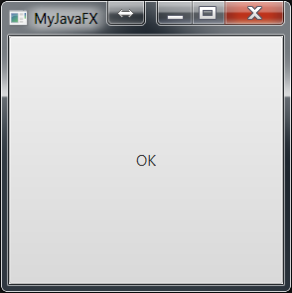
Our First JavaFX Program
Our first JavaFX program will open a window, whose title bar will display “MyJavaFX”, and which will have a (huge) button in the middle labeled “OK”
First, the result, and then the code:

Slide 12
Our First JavaFX Program
import javafx.application.Application;
import javafx.scene.Scene;
import javafx.scene.control.Button;
import javafx.stage.Stage;
public class MyJavaFX extends Application
{
@Override // Override the start method in the Application class
public void start(Stage primaryStage)
{
// Create a scene and place a button in the scene
Button btOK = new Button("OK"); // create a button
Scene scene = new Scene(btOK, 200, 250); // create a scene WITH the button
primaryStage.setTitle("MyJavaFX"); // Set the stage title
primaryStage.setScene(scene); // Place the scene in the stage
primaryStage.show(); // Display the stage
}
/**
* The main method is only needed for the IDE with limited
* JavaFX support. Not needed for running from the command line.
*/
public static void main(String[] args)
{
Application.launch(args);
}
}
Eclipse DOES have enough JavaFX support for us to not need main(). You can completely comment-out (or delete) main(), and this code runs exactly the same under Eclipse

Slide 13
Our First JavaFX Program
JavaFX programs are based on the analogy of a stage (think “theater stage” for the moment).
On the stage are scenes, and each scene is also made up of other components.
On a theater stage, the stage may be divided into portions, where individual scenes take place.
Each scene’s set will have actors, props, backdrops, lighting, etc.
In JavaFX, we create the components, add them to scenes, and then add scenes to the stage

Slide 14
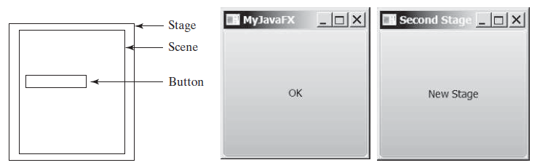
Our First JavaFX Program
In JavaFX, the stage is the window our code runs in
Since every GUI application, by definition, involves a window with the UI, we get the primaryStage by default when the application launches.
Our applications are not limited to a single stage
Just as a music festival may have simultaneous performances on multiple stages, we can have more than one stage (window) in our programs.
The code to set up this two- stage UI is on the next slide

Slide 15
Our First JavaFX Program
import javafx.application.Application;
import javafx.scene.Scene;
import javafx.scene.control.Button;
import javafx.stage.Stage;
public class MultipleStageDemo extends Application
{
@Override // Override the start method in the Application class
public void start(Stage primaryStage)
{
// Create a scene and place a button in the scene
Scene scene = new Scene(new Button("OK"), 200, 250);
primaryStage.setTitle("MyJavaFX"); // Set the stage title
primaryStage.setScene(scene); // Put the scene in the stage
primaryStage.show(); // Display the stage
Stage stage = new Stage(); // Create a new stage
stage.setTitle("Second Stage"); // Set the stage title
// Set a scene with a button in the stage
stage.setScene(new Scene(new Button("New Stage"), 100, 100));
stage.show(); // Display the stage
}
}

Slide 16
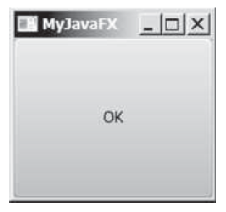
Our First JavaFX Program
By default, stages (windows) are resizable.
Note that we have minimize and maximize buttons
If we want our stage to be of fixed size (i.e., not resizable), we can set that property with stage.setResizeable(false)

Slide 17
Panes, UI Controls, and Shapes

Slide 18
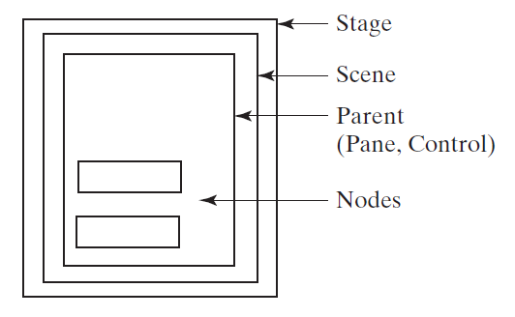
Panes, UI Controls, and Shapes
Previous program we put the button directly on the scene, which centered the button and made it occupy the entire window.
Rarely is this what we really want to do
One approach is to specify the size and location of each UI element (like the buttons)
A better solution is to put the UI elements (known as nodes) into containers called panes, and then add the panes to the scene.

Slide 19
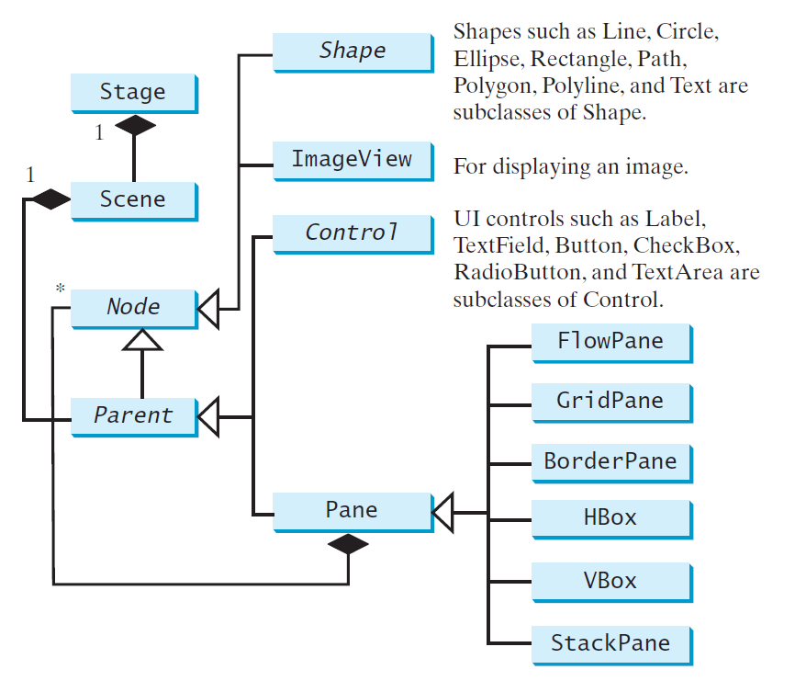
Panes, UI Controls, and Shapes
Panes can even contain other panes:

Slide 20
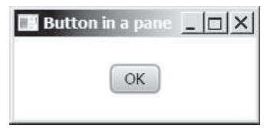
Panes, UI Controls, and Shapes
import javafx.application.Application;
import javafx.scene.Scene;
import javafx.scene.control.Button;
import javafx.stage.Stage;
import javafx.scene.layout.StackPane;
public class ButtonInPane extends Application
{
@Override // Override the start method in the Application class
public void start(Stage primaryStage)
{
StackPane pane = new StackPane(); // Make a pane to work with
// create a new button, and add it to the pane’s list of children
pane.getChildren().add(new Button("OK"));
// Make a new scene, containing the pane
Scene scene = new Scene(pane, 200, 50);
primaryStage.setTitle("Button in a pane"); // Set the stage title
primaryStage.setScene(scene); // Put scene in the stage
primaryStage.show(); // Display the stage
}
}

Slide 21
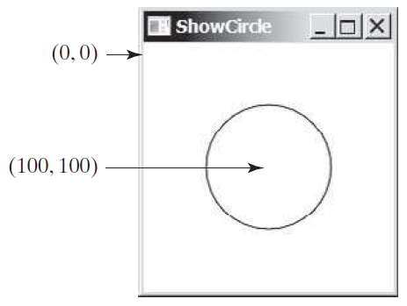
Panes, UI Controls, and Shapes
Beyond the obvious, typical “active” UI elements (things we can interact with, like buttons, etc.), are static shapes – lines, circles, etc.
Lets talk about coordinates within a pane.
The top-left corner of a scene is always (0, 0), and the (positive) X-axis goes to the right, and the (positive)
Y-axis goes down.
Visually, we’re in Cartesian quadrant IV, but Y stays positive.
All coordinates are in pixels

Slide 22
Panes, UI Controls, and Shapes
import javafx.application.Application;
import javafx.scene.Scene;
import javafx.scene.layout.Pane;
import javafx.scene.paint.Color;
import javafx.scene.shape.Circle;
import javafx.stage.Stage;
public class ShowCircle extends Application
{
@Override // Override the start method in the Application class
public void start(Stage primaryStage)
{
// Create a circle and set its properties
Circle circle = new Circle();
circle.setCenterX(100);
circle.setCenterY(100);
circle.setRadius(50);
circle.setStroke(Color.BLACK);
circle.setFill(Color.WHITE);
// Create a pane to hold the circle
Pane pane = new Pane();
pane.getChildren().add(circle);
// Create a 200-x-200 scene from the pane, and place the scene in the stage
Scene scene = new Scene(pane, 200, 200);
primaryStage.setTitle("ShowCircle"); // Set the stage title
primaryStage.setScene(scene); // Place the scene in the stage
primaryStage.show(); // Display the stage
}
}

Slide 23
Property Binding

Slide 24
Property Binding
In the previous example, the (x, y) location of the center of the circle was static – it will always be located at (100, 100).
What if we want it to be centered in the pane, such that if we re-size the window, the circle will move to stay centered?
In order to do so, the circle’s center has to be bound to the pane’s height and width, such that a change to the height or width will force a change to the x or y value of the circle’s center.
This is what property binding is all about

Slide 25
Property Binding
Like most things Java-esque, we get more new terminology
The target object (called the binding object) gets bound to the source object (the bindable object)
When there’s a change to the source, it gets automatically sent to the target.

Slide 26
Property Binding
//import statements have been omitted………
public class ShowCircleCentered extends Application
{
@Override // Override the start method in the Application class
public void start(Stage primaryStage)
{
// Create a pane to hold the circle
Pane pane = new Pane();
// Create a circle and set its properties
Circle circle = new Circle();
circle.centerXProperty().bind(pane.widthProperty().divide(2));
circle.centerYProperty().bind(pane.heightProperty().divide(2));
circle.setRadius(50);
circle.setStroke(Color.BLACK);
circle.setFill(Color.WHITE);
pane.getChildren().add(circle); // Add circle to the pane
// Create a scene and place it in the stage
Scene scene = new Scene(pane, 200, 200);
primaryStage.setTitle("ShowCircleCentered"); // Set the stage title
primaryStage.setScene(scene); // Put scene in stage
primaryStage.show(); // Display the stage
}
}

Slide 27
Property Binding
A pair of simple double property objects (not double values) are created with different values, and then one is bound to the other
Their values are printed out (showing that they are different), the value of one is changed, and then they are both printed again, showing that changing one changed the other.

Slide 28
Property Binding
import javafx.beans.property.DoubleProperty;
import javafx.beans.property.SimpleDoubleProperty;
public class BindingDemo
{
public static void main(String[] args)
{
DoubleProperty d1 = new SimpleDoubleProperty(1);
DoubleProperty d2 = new SimpleDoubleProperty(2);
d1.bind(d2);
System.out.println("d1 is " + d1.getValue()
+ " and d2 is " + d2.getValue());
d2.setValue(70.2);
System.out.println("d1 is " + d1.getValue()
+ " and d2 is " + d2.getValue());
}
}

Slide 29
Property Binding
So far, all of the bindings we have done are one-way – a change in the source causes a change in the target, but not vice versa
If the source and the target are both binding properties and observable properties, then they can serve as both a source and a target, and they can be bound bidirectionally, using the .bindBidirectional method
When two properties are bidirectionally bound, changing either changes the other; both act as sources, and both act as targets.

Slide 30
Common Properties and Methods for Nodes

Slide 31
Common Node Properties & Methods
Nodes share many common properties
This section introduces two – style and rotate
JavaFX style properties are a lot like CSS (Cascading Style Sheets) use to specify styles in HTML (Web) pages.
Thus, it’s known as JavaFX CSS
The official Java documentation on these properties can be found here

Slide 32
Common Node Properties & Methods
In Matlab, we could set both the color and style of a line at once
Similarly, in JavaFX CSS, we can set more than one property at a time
Each property begins with the prefix –fx–, and is of the form styleName:value, with multiple settings separated by semicolons.
For example: circle.setStyle(“-fx-stroke: black; -fx-fill: red;”);
Is equivalent to: circle.setStroke(Color.BLACK); circle.setFill(Color.RED);

Slide 33
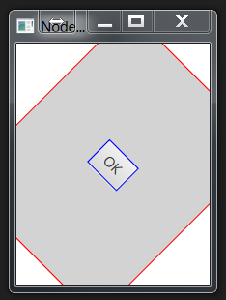
Common Node Properties & Methods
Below example shows a program that creates a button with a blue border, uses JavaFX CSS to set its pane’s style to a red border and a light gray fill, and then rotates the button 45 degrees
Note: positive rotation is clockwise; negative is CCW

Slide 34
Common Node Properties & Methods
import javafx.application.Application;
import javafx.scene.Scene;
import javafx.scene.control.Button;
import javafx.stage.Stage;
import javafx.scene.layout.StackPane;
public class NodeStyleRotateDemo extends Application
{
@Override // Override the start method in the Application class
public void start(Stage primaryStage)
{
// Create a scene and place a button in the scene
StackPane pane = new StackPane();
Button btOK = new Button("OK");
btOK.setStyle("-fx-border-color: blue;"); // create blue-bordered button
pane.getChildren().add(btOK);
pane.setRotate(45); // rotate pane and set its style before adding to scene
pane.setStyle("-fx-border-color: red; -fx-background-color: lightgray;");
Scene scene = new Scene(pane, 200, 250);
primaryStage.setTitle("NodeStyleRotateDemo"); // Set the stage title
primaryStage.setScene(scene); // Place the scene in the stage
primaryStage.show(); // Display the stage
}
}

Slide 35
The Color Class

Slide 36
The Color Class
Images are made up of pixels, and each pixel is made up of a red component, a green component, and a blue component, and that mixing these three components allows us to produce a huge number of colors
JavaFX uses this same color model, but adds a fourth “component” to a pixel – its opacity.
In some image processing literature, this opacity is sometimes referred to as the Alpha channel

Slide 37
The Color Class
There are 3 sets of color constructors (“mixers”):
The ones named Color (or color) require double values ∈ [0.0, 1.0] for the R/G/B/A components
The ones named rgb require int values ∈ [0, 255]
The hsb (Hue, Saturation, Brightness) / hsba color models are also supported
Just like String, Color is immutable.
If we want a lighter version of this Color, we can use .lighter(), but we get a NEW color, rather than changing the value of the current color, just like .toUpperCase doesn’t change a String; it gives us a new one with upper case characters.

Slide 38
The Color Class
+Color(r: double, g: double, B:double, opacity:double)
+brighter(): color
+darker(): color
+color(r: double, g: double, B:double, opacity:double): Color
+color(r: double, g: double, B:double ): Color
+rgb(r: int, g: int, b: int, opacity: int): Color
+rgb(r: int, g: int, b: int ): Color
The color() and rgb() methods are static, and don’t require instantiating a color
Also, we can use named color constants: BEIGE, BLACK, BLUE, BROWN, CYAN, DARKGRAY, … There are about 150 of them.

Slide 39
The Font Class

Slide 40
The Font Class
We tend to think of “font” as being “Arial”, “Times New Roman”, “Calibri”, etc., but those are font names (more precisely, they’re typeface names)
A full font specification requires the font name, weight, posture, and size

Slide 41
The Font Class
We typically use just “NORMAL” or “BOLD” for the FontWeights, but there’s a whole spectrum: THIN EXTRA_LIGHT LIGHT NORMAL MEDIUM SEMI_BOLD BOLD EXTRA_BOLD BLACK
FontPosture, however, comes in exactly two flavors: REGULAR and ITALIC
You can get a listing of all of the font family names installed on the computer with .getFamilies()

Slide 42
The Image and ImageView Classes

Slide 43
The Image & ImageView Classes
We used the File class to hold information about a file, but not to actually read / write to it
For that we used a Scanner / PrintWriter, connected to the File object
Similarly, the Image class is a container for an image, but can’t be used to actually display an image
For that, we use the ImageView node (and attach it to a scene)

Slide 44
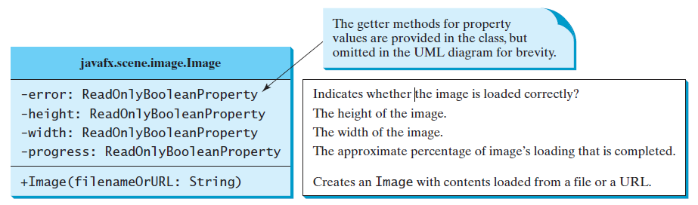
The Image & ImageView Classes
The Image class (the data types should be ReadOnlyDoubleProperty for all except error):
We construct an Image from a filename (or a URL), and then we can give the Image to an ImageView object to actually display it

Slide 45
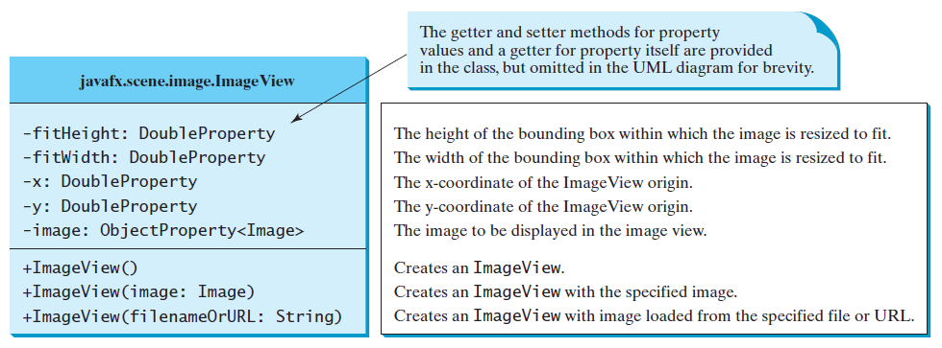
The Image & ImageView Classes
The ImageView class:

Slide 46

The Image & ImageView Classes
// Bunch of omitted Import statements, Class header, and start() header
{
// This is just the BODY of start()
// Create a pane to hold the image views
Pane pane = new HBox(10); // HBox is covered in next section
pane.setPadding(new Insets(5, 5, 5, 5));
Image image = new Image("image/us.gif"); // Load image from file
pane.getChildren().add(new ImageView(image)); // 1st IV gets image as-is
ImageView imageView2 = new ImageView(image); // 2nd IV forces image to
imageView2.setFitHeight(100); // fit into 100-x-100
imageView2.setFitWidth(100); // pixel area
pane.getChildren().add(imageView2);
ImageView imageView3 = new ImageView(image); // 3rd IV leaves size as-is,
imageView3.setRotate(90); // but rotates (CW) 90 deg,
pane.getChildren().add(imageView3);
// Create a scene and place it in the stage
Scene scene = new Scene(pane);
primaryStage.setTitle("ShowImage"); // Set the stage title
primaryStage.setScene(scene); // Place scene in stage
primaryStage.show(); // Display the stage
}

Slide 47
The Image & ImageView Classes
The HBox is a pane that handles placement of multiple nodes for us automatically.
As we add nodes to the HBox, they are automatically added in a row (horizontally)

Slide 48
Layout Panes

Slide 49
Layout Panes
So far we add our Nodes to a Pane, and then add the Pane to a Scene, and then the Scene to a Stage (probably the primary stage).
How do we arrange (i.e., lay out) the Nodes on the pane?
Java has several different kinds of Panes that do a lot of the layout work for us.
Previous example the Pane , HBox, and StackPane are used; we’ll start with the FlowPane…

Slide 50
Layout Panes
Name | Description
Pane | Base class for layout panes. Use its getChildren() method to return the list of nodes on the pane (or add to that list) Provides no particular layout capabilities – it’s a “blank canvas” typically used to draw shapes on
StackPane | Places nodes on top of each other in the center of the pane
FlowPane | Places the notes row-by-row horizontally or column-by-column vertically (reading order)
GridPane | Provide a 2-D grid of cells, into which we can place nodes
BorderPane | Divides pane into top, bottom, left, right, and center regions
HBox | Places nodes in a single (horizontal) row
VBox | Places nodes in a single (vertical) column

Slide 51
The FlowPane
The FlowPane can be set up to work in “reading order”, by using Orientation.HORIZONTAL or in sequential top-to-bottom columns (Orientation.VERTICAL)
One can also specify the gap between nodes (in pixels)
So far, we have seen putting Button and ImageView nodes on a pane.
Example below uses the FlowPane and Label & TextField nodes.

Slide 52
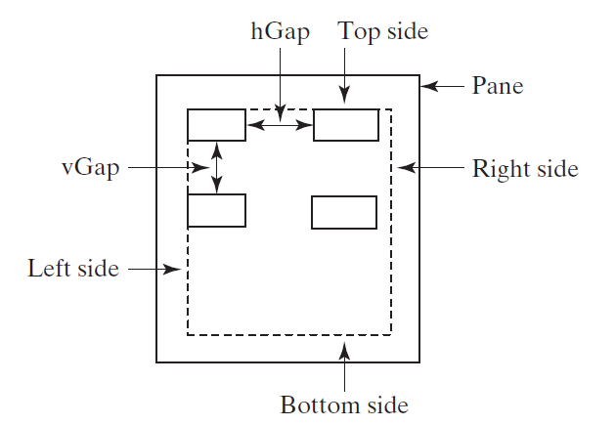
The FlowPane
public void start(Stage primaryStage)
{
// Create a pane and set its properties
FlowPane pane = new FlowPane();
pane.setPadding(new Insets(11, 12, 13, 14));
pane.setHgap(5);
pane.setVgap(5);
// Place nodes in the pane
pane.getChildren().addAll(new Label("First Name:"),
new TextField(), new Label("MI:"));
TextField tfMi = new TextField();
tfMi.setPrefColumnCount(1);
pane.getChildren().addAll(tfMi, new Label("Last Name:"),
new TextField());
// Create a scene and place it in the stage
Scene scene = new Scene(pane, 200, 250);
primaryStage.setTitle("ShowFlowPane"); // Set the stage title
primaryStage.setScene(scene); // Put scene in stage
primaryStage.show(); // Display the stage
}
Setting the padding with an Insets object gives us a margin inside the pane. Just as angles are always clockwise, the Insets are specified in clockwise order from the top, so this pane will have an 11-pixel gap between the top of the pane and the first row, a 12-pixel gap between the right-most node and the right side of the pane, 13 pixels at the bottom, and 14 pixels on the left side.
The Hgap and Vgap properties specify the gap between elements on the same row, or between rows
Resizing the window “re-flows” the nodes, just as changing the page size in Word re-flows your text.

Slide 53
The FlowPane
public void start(Stage primaryStage)
{
// Create a pane and set its properties
FlowPane pane = new FlowPane();
pane.setPadding(new Insets(11, 12, 13, 14));
pane.setHgap(5);
pane.setVgap(5);
// Place nodes in the pane
pane.getChildren().addAll(new Label("First Name:"),
new TextField(), new Label("MI:"));
TextField tfMi = new TextField();
tfMi.setPrefColumnCount(1);
pane.getChildren().addAll(tfMi, new Label("Last Name:"),
new TextField());
// Create a scene and place it in the stage
Scene scene = new Scene(pane, 200, 250);
primaryStage.setTitle("ShowFlowPane"); // Set the stage title
primaryStage.setScene(scene); // Put scene in stage
primaryStage.show(); // Display the stage
}
The example introduces two new nodes: Label (which just lets us display text on a pane), and TextField (which provides a box into which the user can type text).
TextField nodes typically have a corresponding Label, so the user can tell what’s supposed to go IN the TextField
We can .add() individual nodes to a pane, or we can .addAll() to add a list of nodes, as is done here.
We add a Label of “First Name:”, and then a TextField into which the user can type their first name, and then another Label for “MI:” (“Middle Initial”).

Slide 54
The FlowPane
public void start(Stage primaryStage)
{
// Create a pane and set its properties
FlowPane pane = new FlowPane();
pane.setPadding(new Insets(11, 12, 13, 14));
pane.setHgap(5);
pane.setVgap(5);
// Place nodes in the pane
pane.getChildren().addAll(new Label("First Name:"),
new TextField(), new Label("MI:"));
TextField tfMi = new TextField();
tfMi.setPrefColumnCount(1);
pane.getChildren().addAll(tfMi, new Label("Last Name:"),
new TextField());
// Create a scene and place it in the stage
Scene scene = new Scene(pane, 200, 250);
primaryStage.setTitle("ShowFlowPane"); // Set the stage title
primaryStage.setScene(scene); // Put scene in stage
primaryStage.show(); // Display the stage
}
Next, we create another TextField for the Middle Initial, and set its preferred column count to 1 (if it’s only going to hold an initial, why make a “wide” box to hold it?)
Note: the TextField’s variable is prefixed with “tf”. Node variables are typically prefixed with an abbreviation of its type, so we can tell from looking at the variable what kind of variable it is

Slide 55
The FlowPane
public void start(Stage primaryStage)
{
// Create a pane and set its properties
FlowPane pane = new FlowPane();
pane.setPadding(new Insets(11, 12, 13, 14));
pane.setHgap(5);
pane.setVgap(5);
// Place nodes in the pane
pane.getChildren().addAll(new Label("First Name:"),
new TextField(), new Label("MI:"));
TextField tfMi = new TextField();
tfMi.setPrefColumnCount(1);
pane.getChildren().addAll(tfMi, new Label("Last Name:"),
new TextField());
// Create a scene and place it in the stage
Scene scene = new Scene(pane, 200, 250);
primaryStage.setTitle("ShowFlowPane"); // Set the stage title
primaryStage.setScene(scene); // Put scene in stage
primaryStage.show(); // Display the stage
}
Finally, we go back to the task of adding the (narrow) Middle Initial TextField, plus a Label and a TextField for the last name to the pane.
Now we have Label / TextField pairs for First Name, Middle Initial (a one-character-wide TextField), and Last Name

Slide 56
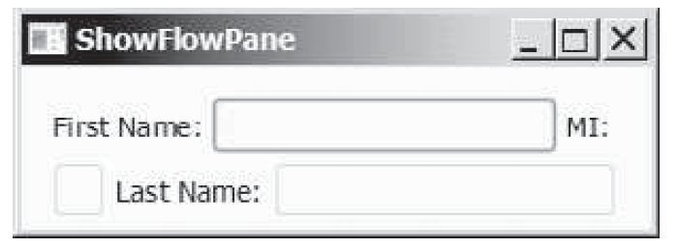
The FlowPane
This is the stage we have built:
Because we went in “reading order”, and added the nodes in the order we did, we got this – the “MI:” label is next to the tfMi TextField in reading order, but this isn’t visually appealing.

Slide 57
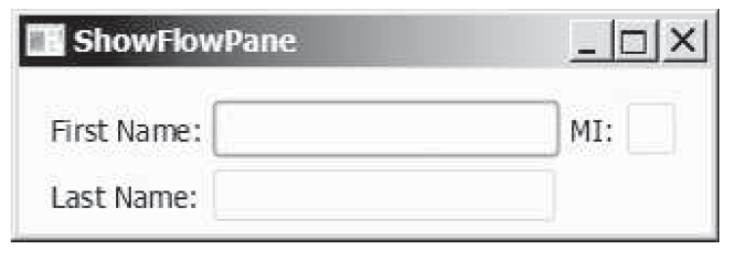
The FlowPane
If we make the scene wider (enlarge the window)
The elements “re-flow”, and now the MI TextField fits on the same row as its Label

Slide 58
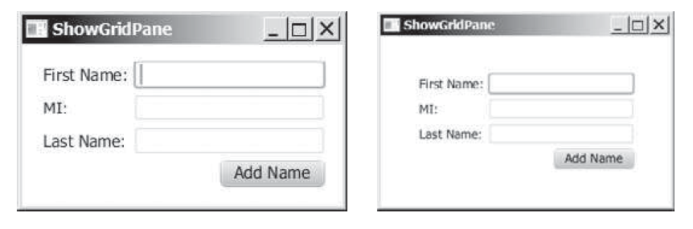
The GridPane
A few notes:
The “Add” button is right-aligned within its cell
The whole frame is centered
The labels get the default horizontal alignment of “left”
We specify the column first (backwards from arrays)
Not every cell needs to be filled
Elements can be moved from one cell to another

Slide 59
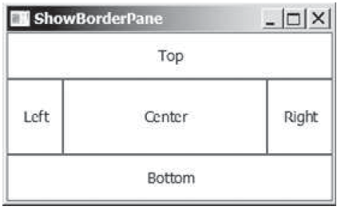
The BorderPane
The BorderPane divides the pane into five “regions”

Slide 60
HBox and VBox
The FlowPane gave us rows and columns (in reading order)
The HBox and VBox panes give us a single row or column (respectively)

Slide 61
Shapes

Slide 62
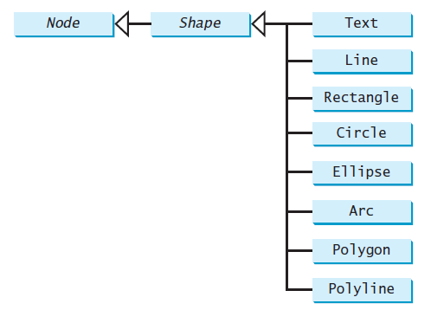
Shapes
8 shapes we can use to dress up our panes:

Slide 63
Shapes
All of the shapes have some common properties:
fill (color)
stroke (line color)
strokeWidth (how heavy the stroke line is)

Slide 64
Text
The Text shape lets us put text on a pane
“Wait, doesn’t a Label let us do the same thing?”
Well, yes and no.
They’re two different kinds of text, with two different inheritance paths.
The Label is a non-editable text control.
The Text class defines a node that displays a text.
The text we place as a Shape can have its color, font (typeface, weight, size, and posture), underline, and strikethrough properties set.
Once placed, we can move text by using setX() and setY() to give it a new location

Slide 65
Line
Each line is specified by its two endpoints: startX, startY and endX, endY (all doubles, in pixels)

Slide 66
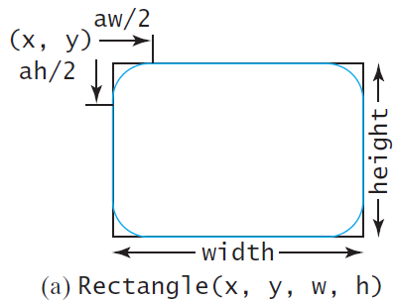
Rectangle
The Rectangle shape is specified by its top-left corner (x, y) and its width and height.
Optionally, we can specify the arcWidth and arcHeight (in pixels) of the corners, to create rounded corners (arc measurements of 0 make squared-off corners)

Slide 67
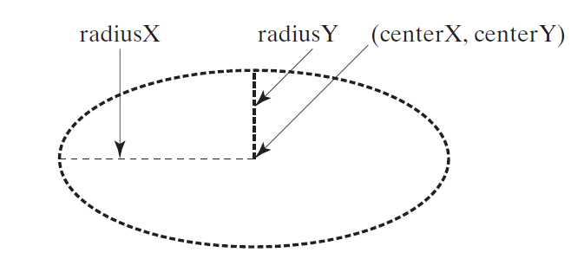
Circle and Ellipse
The Circle and Ellipse shapes are very similar, as you might expect
Both are specified by their center point (centerX, centerY)
The Circle has a single radius
The Ellipse has two radii (radiusX & radiusY)

Slide 68
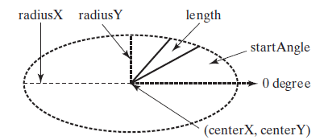
Arc
An Arc is just part of an Ellipse
An Arc is specified by its center point, radii, start angle (in degrees), and length (in degrees)
If the two radii are equal, then it’s a circular arc
Angles may be negative (clockwise sweep)

Slide 69
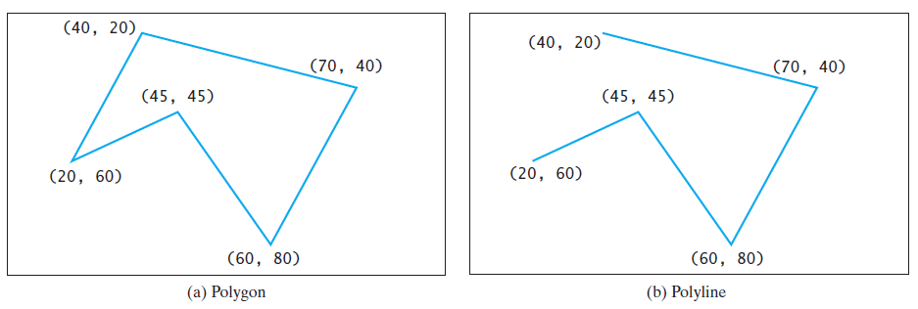
Polygon and Polyline
The Polygon and Polyline shapes are identical, except that the Polyline isn’t closed
Both are specified by a list of (x, y) pairs

Slide 70
Polygon and Polyline
Pane pane = new Pane(); // create a pane
Polygon polygon = new Polygon(); // create a polygon
pane.getChildren().add(polygon); // add the polygon to the pane
polygon.setFill(Color.WHITE); // polygon will be filled in white
polygon.setStroke(Color.BLACK); // with a black border
ObservableList<Double> list = polygon.getPoints(); // get its vertex list
final double WIDTH = 200, HEIGHT = 200; // See Fig. (a)
double centerX = WIDTH / 2, centerY = HEIGHT / 2; //
double radius = Math.min(WIDTH, HEIGHT) * 0.4; //
// Generated and add (x, y) points to the polygon’s vertex list
for (int i = 0; i < 6; i++)
{
list.add(centerX + radius * Math.cos(2 * i * Math.PI / 6));
list.add(centerY - radius * Math.sin(2 * i * Math.PI / 6));
}
// Create a scene and place it in the stage
Scene scene = new Scene(pane, WIDTH, HEIGHT);
primaryStage.setTitle("ShowPolygon"); // Set the stage title
primaryStage.setScene(scene); // Put scene in stage
primaryStage.show(); // Display the stage

Slide 71
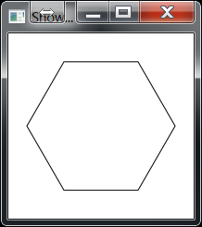
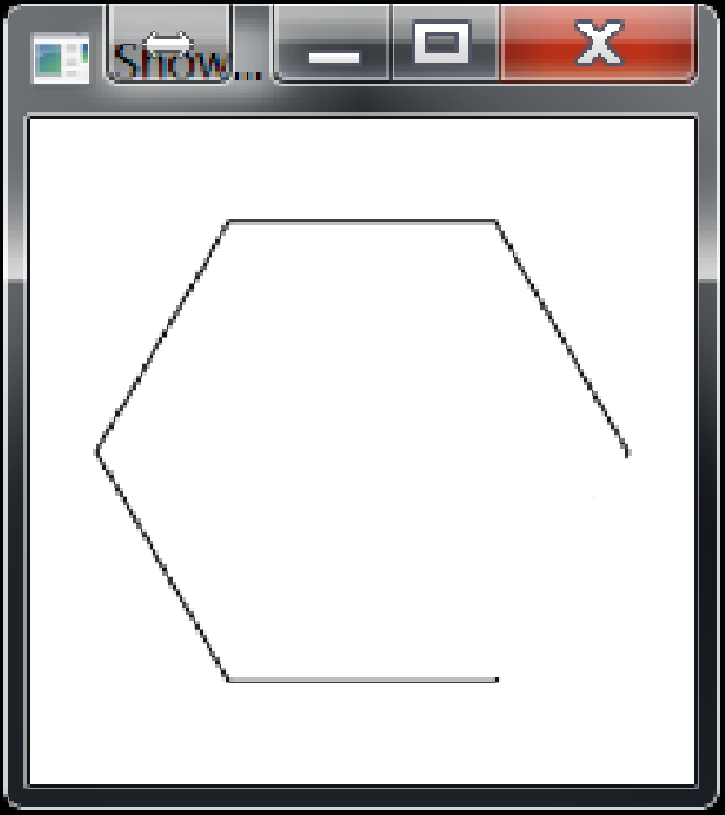
Polygon and Polyline
In the preceding code, if we change Polygon to Polyline, everything else stays the same, except the last line segment to close the figure isn’t drawn, and rather than this…
…we get this

